Slide 1
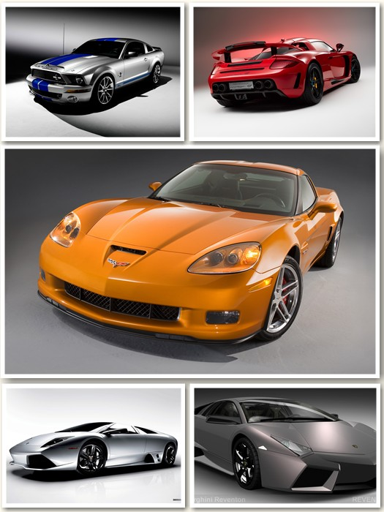
Analyzing and Predicting Car Prices in the Australian Market
CSIS 3360
Carlos Sibaja
John Zapana
Esta foto de Autor desconocido está bajo licencia CC BY-SA-NC
Notes:
John

Slide 2
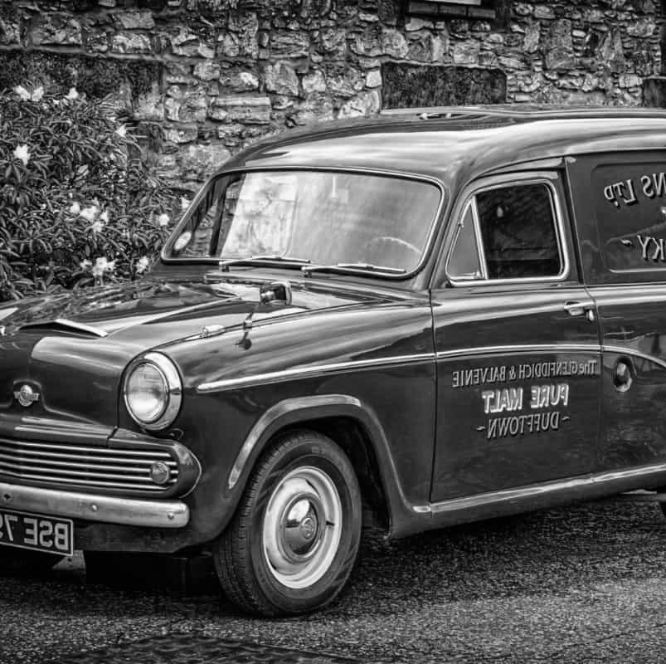
TABLE OF CONTENT
Project Overview
Exploratory Data Analysis (EDA)
Data Cleaning
Insights
Clustering
Classification Model
Predictive Models
Learnings
Conclusions
Notes:
Project Overview John
EDA John
Clustering John
Classification Model Carlos
Predictive Models Carlos
Learnings Carlos
Conclusions Carlos.

Slide 3

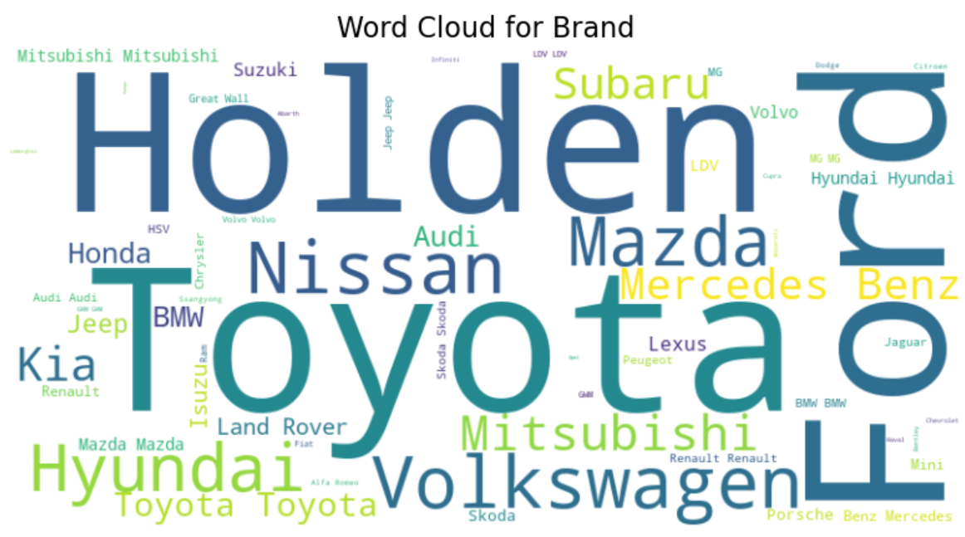
DATA SET
SOURCE
https://www.kaggle.com/datasets/lainguyn123/australia-car-market-data
There are new and used cars from 1989 to 2022, and there are several brands and types.
Brands was created by python

Slide 4
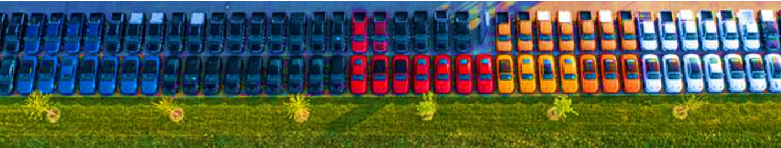
PROJECT GOALS AND OBJECTIVES:
Analyze the Australian Car Market dataset to explore insights and build predictive models.
The goal is to identify factors influencing car pricing, discover trends and groupings, and recommend the best model for predicting car prices

Slide 5
DATA SET
This dataset provides information about the car market in Australia
Number | Variable Name | Description | Observations | Nulls | Type of Variable
1 | ID | Car Code | 17048 | non-null | int64
2 | Name | Car Name | 17048 | non-null | object
3 | Price | Car Price | 17048 | non-null | int64
4 | Brand | Car Brand | 17048 | non-null | object
5 | Model | Car Model Year | 17048 | non-null | object
6 | Variant | Car Variant | 17048 | non-null | object
7 | Series | Car Series | 17048 | non-null | object
8 | Year | Year of Manufacture | 17048 | non-null | int64
9 | Gearbox | Gearbox Type | 17048 | non-null | int64
10 | Type | Body Design or Car body | 17048 | non-null | object
11 | Fuel | Fuel Type | 17048 | non-null | object
12 | Status | Car Condition | 17048 | non-null | object
13 | Kilometers | Mileage | 17048 | non-null | object
14 | CC | Engine Capacity | 17048 | non-null | int64
15 | Color | Car Color | 17048 | non-null | object
16 | Seating Capacity | Seating Capacity | 17048 | non-null | int64
16 columns,
No missing values,
No duplicated values,

Slide 6
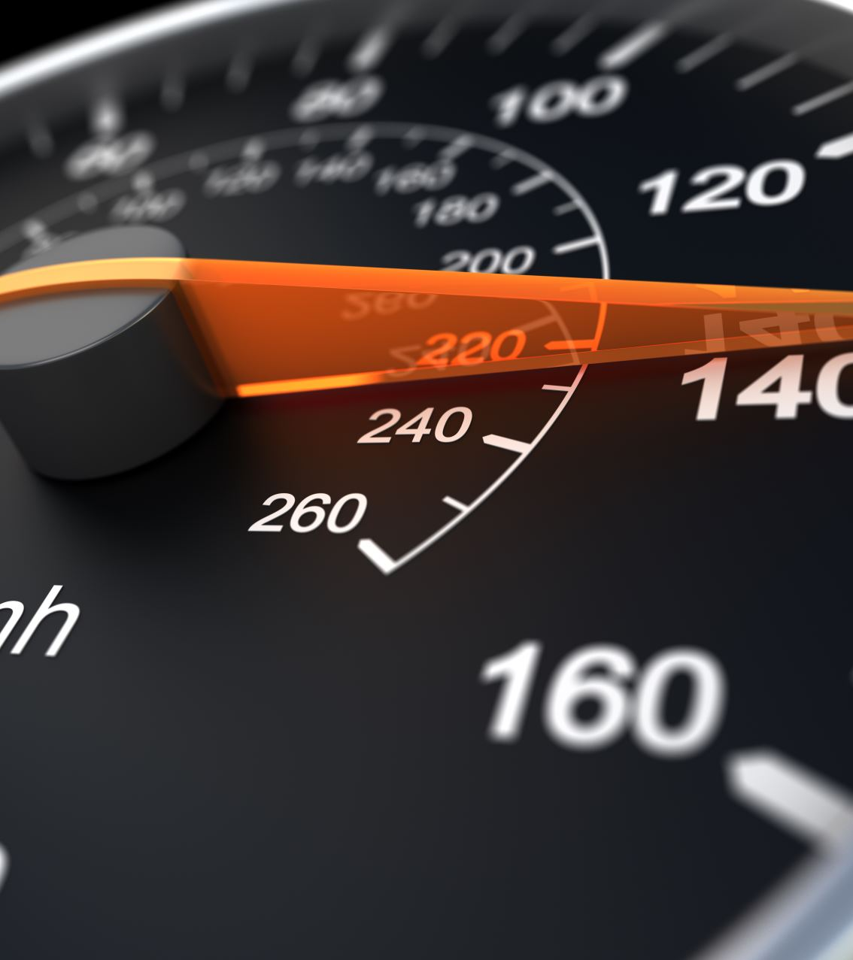
DATASET DETAILS
The dataset has 16 columns with no missing values. Here's a breakdown of its key features:
Price (Target Variable): Price (The price of the car).
Numerical Features: Year, Kilometers (Mileage), CC (Engine Capacity), and Seating Capacity.
Categorical Features: Brand, Variant, Series, Type, Gearbox, Fuel, Status (Car Condition), and Color.

Slide 7

DATA EXPLORATION
Holden is an Australian automaker, established in 1856
58 Brands! in total

Slide 8
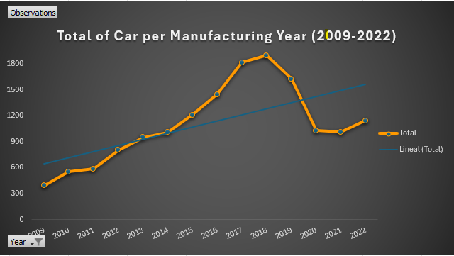
DATA EXPLORATION

Slide 9

Key Questions
Are there specific clusters of cars based on attributes?
Can we predict car prices using regression models?
What factors most influence car prices?
Are there specific classification of cars?

Slide 10
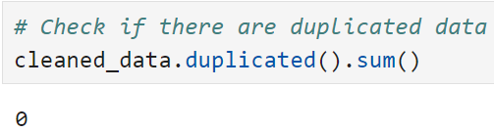
Exploratory Data Analysis (EDA)
Conduct a thorough analysis to uncover patterns and relationships in the data:
Data Cleaning:
Check for spaces from all object (string) columns.
Check for duplicate records.
Drop irrelevant columns (ID, Name, Model, Variant, Series, Color)
Rename columns for better clarity.
Standardize columns: Brand, Type, Gearbox, Fuel, Car Condition

Slide 11
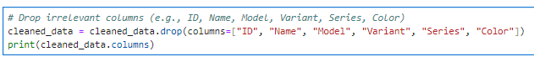
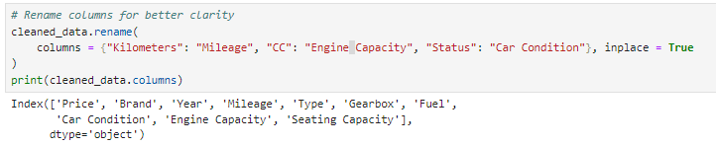
Example of the Data Cleaning Performed

Slide 12
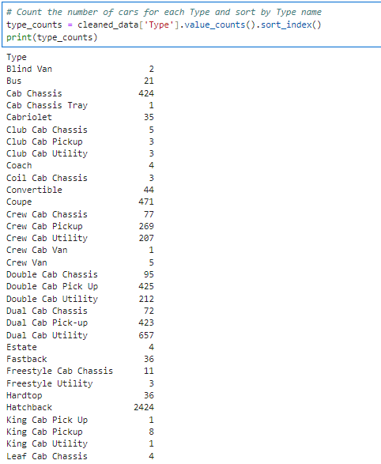
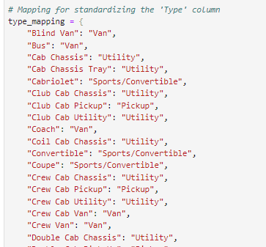
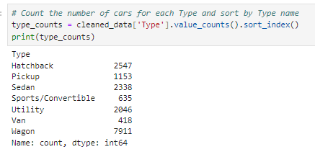
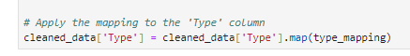
Example of Standardizing for the 'Type' column

Slide 13
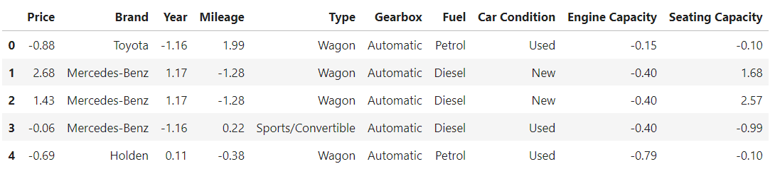
Feature Transformation:
Scale numerical features (e.g., Price, Mileage, Engine Capacity, Seating Capacity) using StandardScaler

Slide 14

Data Preprocessing
Boxplots to identify outliers in Price, Mileage and Engine Capacity.
Remove or cap outliers (e.g., extremely high or low prices or mileage).
A heatmap of correlations to explore relationships between numerical variables like Year, Mileage, Engine Capacity, Seating Capacity, and Price.
Scatterplots (e.g., Year vs. Price, Mileage vs. Price, Engine Capacity vs. Price, Seating Capacity vs. Price) to visualize trends.
Esta foto de Autor desconocido está bajo licencia CC BY-NC-ND

Slide 15
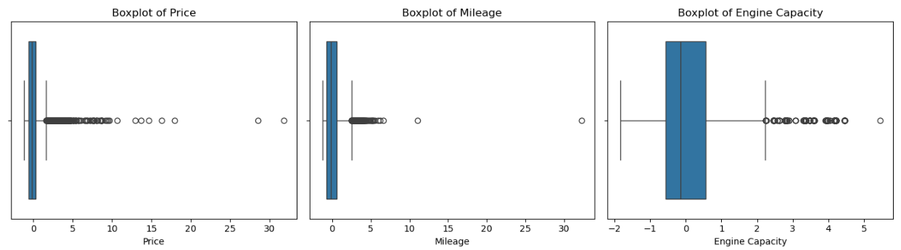
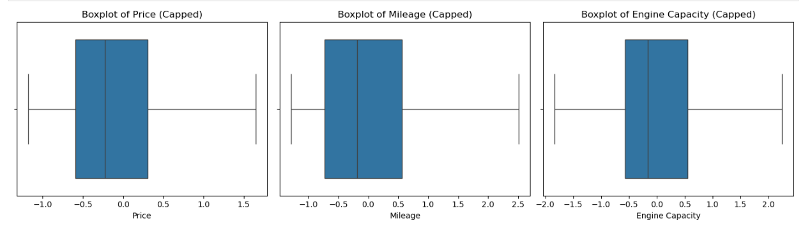
Notes:
Scale numerical features (e.g., Price, Mileage, Engine Capacity, Seating Capacity) using StandardScaler for Visualizations and Models.

Slide 16
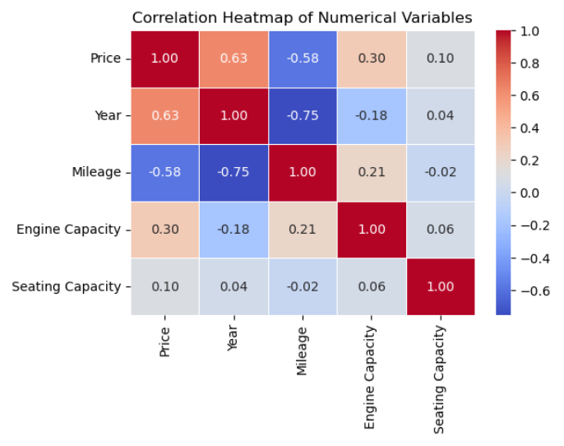
Heatmap of correlations

Slide 17
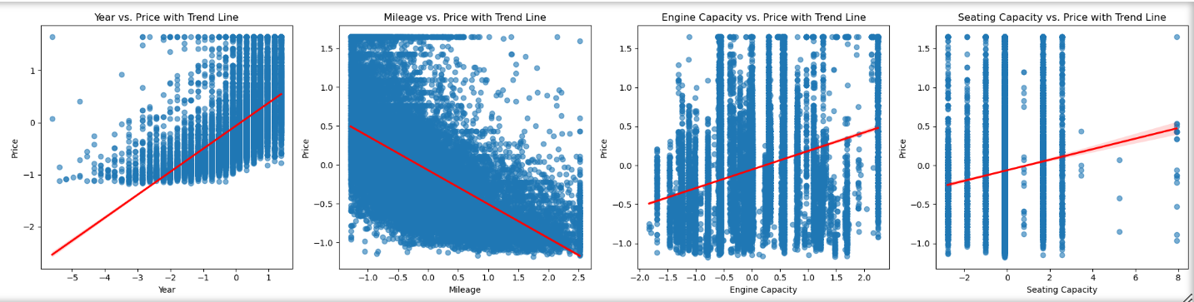
Scatterplots with a Trend Line

Slide 18
Insights
Features with the Strongest Correlation to Car Price:
Year: Has a moderate positive correlation with Price (~0.63), suggesting newer cars tend to cost more.
Mileage: Shows a negative correlation with Price (~ -0.58), indicating that higher mileage generally reduces a car's value.
Engine Capacity and Seating Capacity show weaker relationships but can still contribute to price variability.

Slide 19
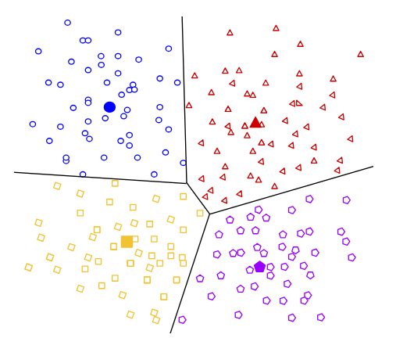
CLUSTERING
CLUSTERING
CLUSTERING
Determine the optimal number of clusters (k) using the Elbow Method.
Use K-Means Clustering.
Notes:
Definition: Clustering is an unsupervised learning method where the goal is to group data points into clusters based on their similarities, without using labeled data.

Slide 20
Objective:
Group cars based on similar attributes to identify distinct segments.
Features for Clustering:
Select relevant features: Price, Year, Mileage, Car Condition, and Fuel.
These features will be used to form the clusters, and K-Means will try to group cars that have similar values in these features.
Convert categorical variables (e.g., Fuel, Car Condition) into dummy/encoded variables.
CLUSTERING
Notes:
Clustering is a technique used in unsupervised machine learning that involves grouping a set of objects in such a way that objects in the same group (called a cluster) are more similar (in some sense) to each other than to those in other groups

Slide 21
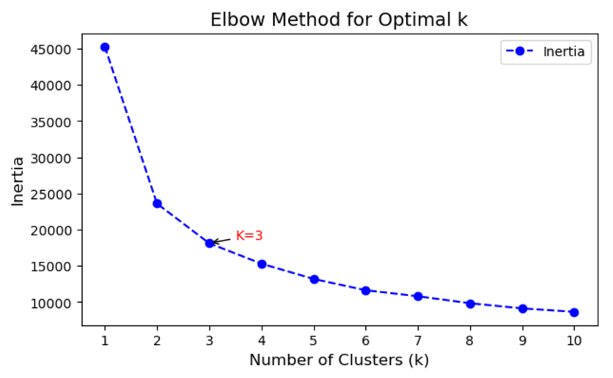
CLUSTERING
CLUSTERING
The goal is to find the point where the decrease in inertia starts to slow down and form an "elbow" in the curve

Slide 22
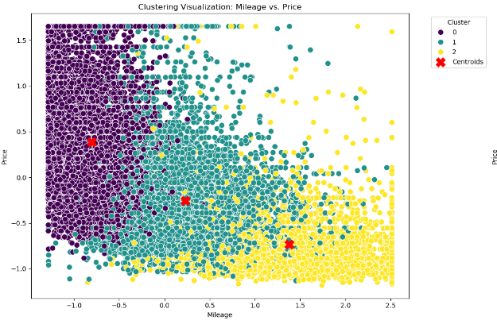
CLUSTERING
CLUSTERING

Slide 23
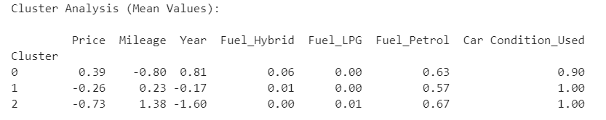
Cluster Analysis (Mean Values)
Cluster 0 (Higher Price):
Represents premium cars and is very new with low mileage.
Cluster 1 (Mid Price):
Represents mid-range cars with balanced options (reasonable pricing, average mileage, moderately old).
Cluster 2 (Lower Price):
It represents budget cars that are mainly used, regardless of age or mileage.

Slide 24
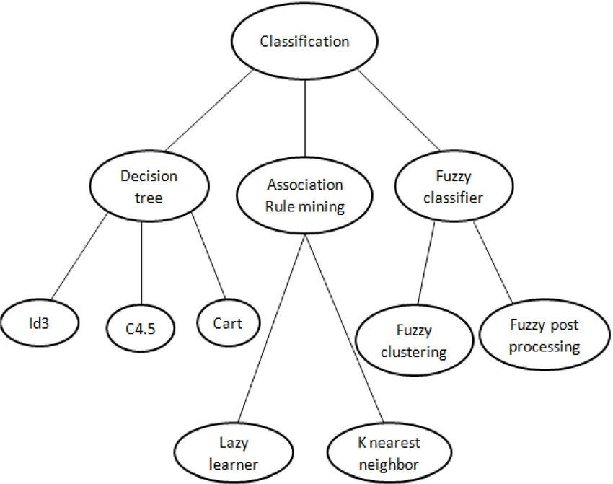
CLASSIFICATION MODEL
Classification
CLUSTERING
Decision Trees
Random Forest
Naïve Bayes
Classify a car into a price range
(e.g., low, medium, high)

Slide 25
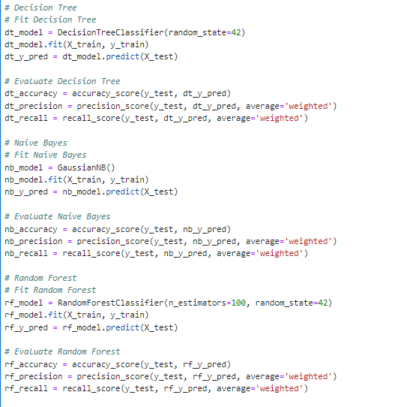
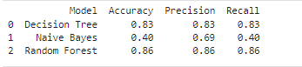
Conclusion: The decision Random Forest performs much better across all metrics than the Other models. It has much higher accuracy, precision, and recall, making it the better choice for this classification task.

Slide 26
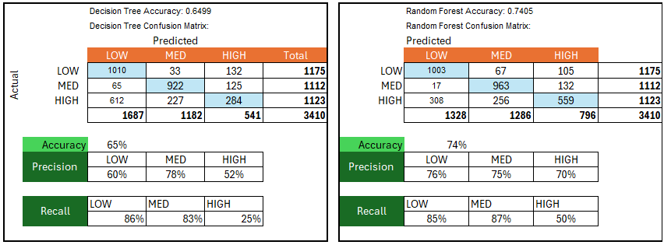
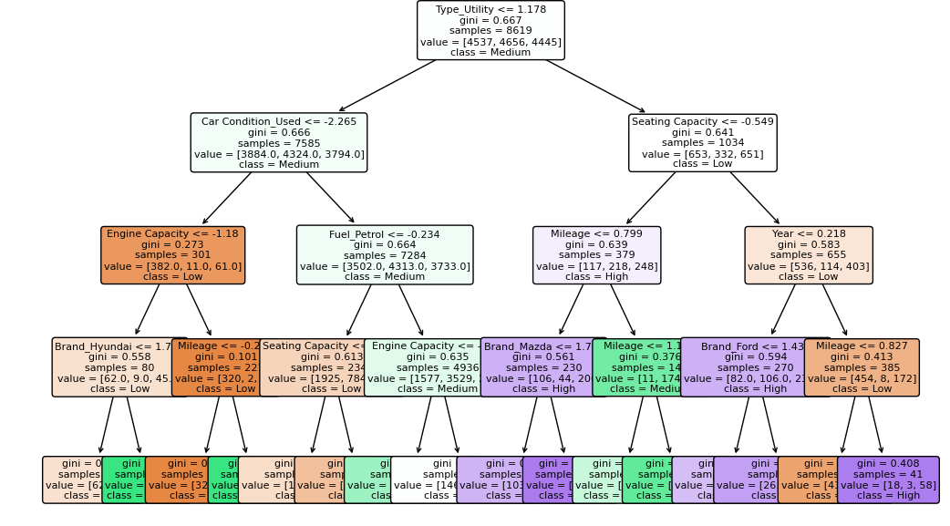
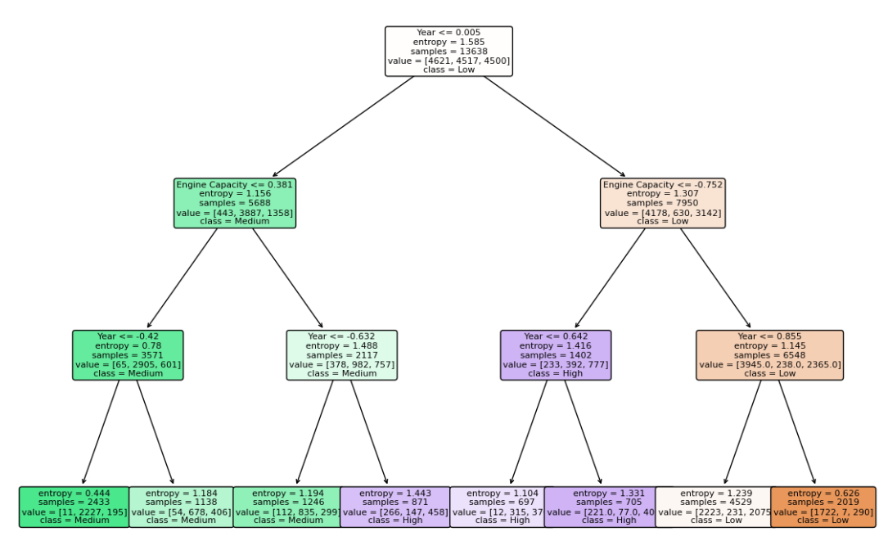

Slide 27
PREDICTIVE MODELS
Objective:
Predict car prices based on features.
Features for Clustering:
Select relevant features: Price, Year, Mileage, Engine Capacity, Seating Capacity, Type, Gearbox, Fuel, Car Condition.
Convert categorical variables (e.g., Fuel, Car Condition) into dummy/encoded variables.
LINEAR REGRESSION
XG BOOST
RANDOM FOREST
Notes:
Random forest is a machine learning technique that builds on the simplicity of decision trees and improves their predictive performance by combining the results of several trees to form a "forest". It works by constructing numerous decision trees at training time and outputs the mode of the classes (for classification tasks) or the mean prediction (for regression tasks) of the individual trees.
XGBoost (Extreme Gradient Boosting) is a powerful and efficient machine learning algorithm based on gradient boosting. It is widely used for supervised learning tasks like classification and regression due to its high performance, scalability, and ability to handle missing data. XGBoost optimizes model accuracy by using advanced techniques like regularization, parallel processing, and tree pruning. designed to improve the performance and efficiency of decision tree-based models
What Do You Gain with XGBoost in Regression?
Improved Predictive Power: It often yields higher accuracy than traditional regression methods because of its ability to capture complex patterns.
Robustness: Handles missing values, outliers, and noise better than many algorithms.
Speed: XGBoost is faster than most other gradient boosting implementations, which is crucial for large datasets or real-time applications.
Automation: It requires minimal preprocessing (e.g., handling missing values and scaling are less critical).

Slide 28
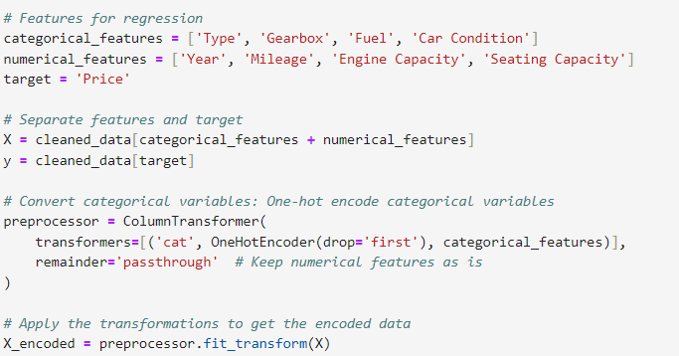
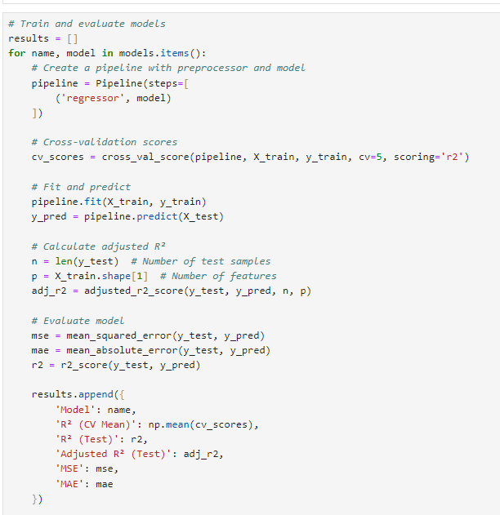
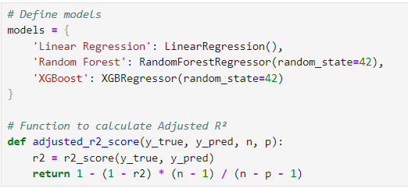
LINEAR REGRESSION
Extract of the Code in Python.
MODEL

Slide 29
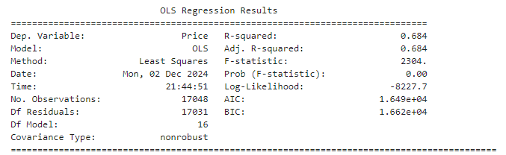
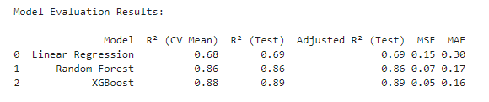
LINEAR REGRESSION
Results
Notes:
XGBoost stands for eXtreme Gradient Boosting. It is a highly efficient and scalable implementation of gradient boosting, a machine-learning technique used for regression.
The main advantage of XGBoost over Linear Regression lies in its ability to handle non-linear relationships between features and the target variable

Slide 30
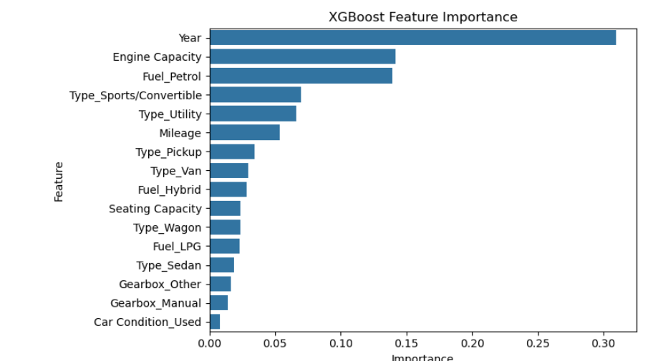
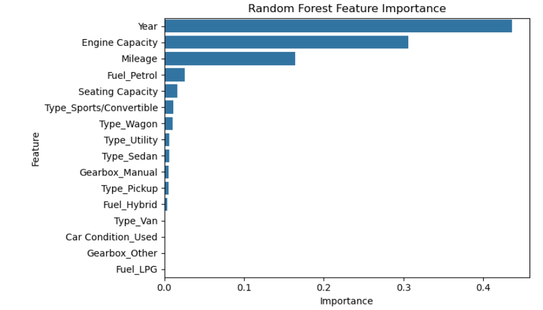
Features have the most significant impact on car prices.

Slide 31

Learnings and Challenges
You don’t know if a model is good or not until you try it. We dropped two datasets.
Some models are complicated to do in Excel.
You need to run the model several times to do fine-tuning.
CSV files are not XLMs; save it in the correct way to avoid losing the work.
Python is an excellent tool for data science.
- Tools: Excel, Anaconda, Jupyter Notebook, PPT
Git Hub
Esta foto de Autor desconocido está bajo licencia CC BY-NC-ND

Slide 32
CONCLUSIONS
The project successfully analyzed the Australian car market dataset and identified key factors influencing car prices. Through EDA and modelling, Year, Mileage, and Engine Capacity emerged as the most significant predictors of car price.
Among the models evaluated:
XGBoost was the most robust for regression tasks, achieving the highest R² and lowest error metrics.
Random Forests was the best for classification model, categorizing cars into price ranges with high accuracy, precision, and recall.
Clustering analysis added value by segmenting cars into meaningful groups, aiding market targeting and pricing strategies. The integration of multiple methods—EDA, clustering, regression, and classification—provided a holistic view of the dataset and effectively addressed the project’s objectives.
Notes:
EDA Exploratory Data Analysis

